Slide 1
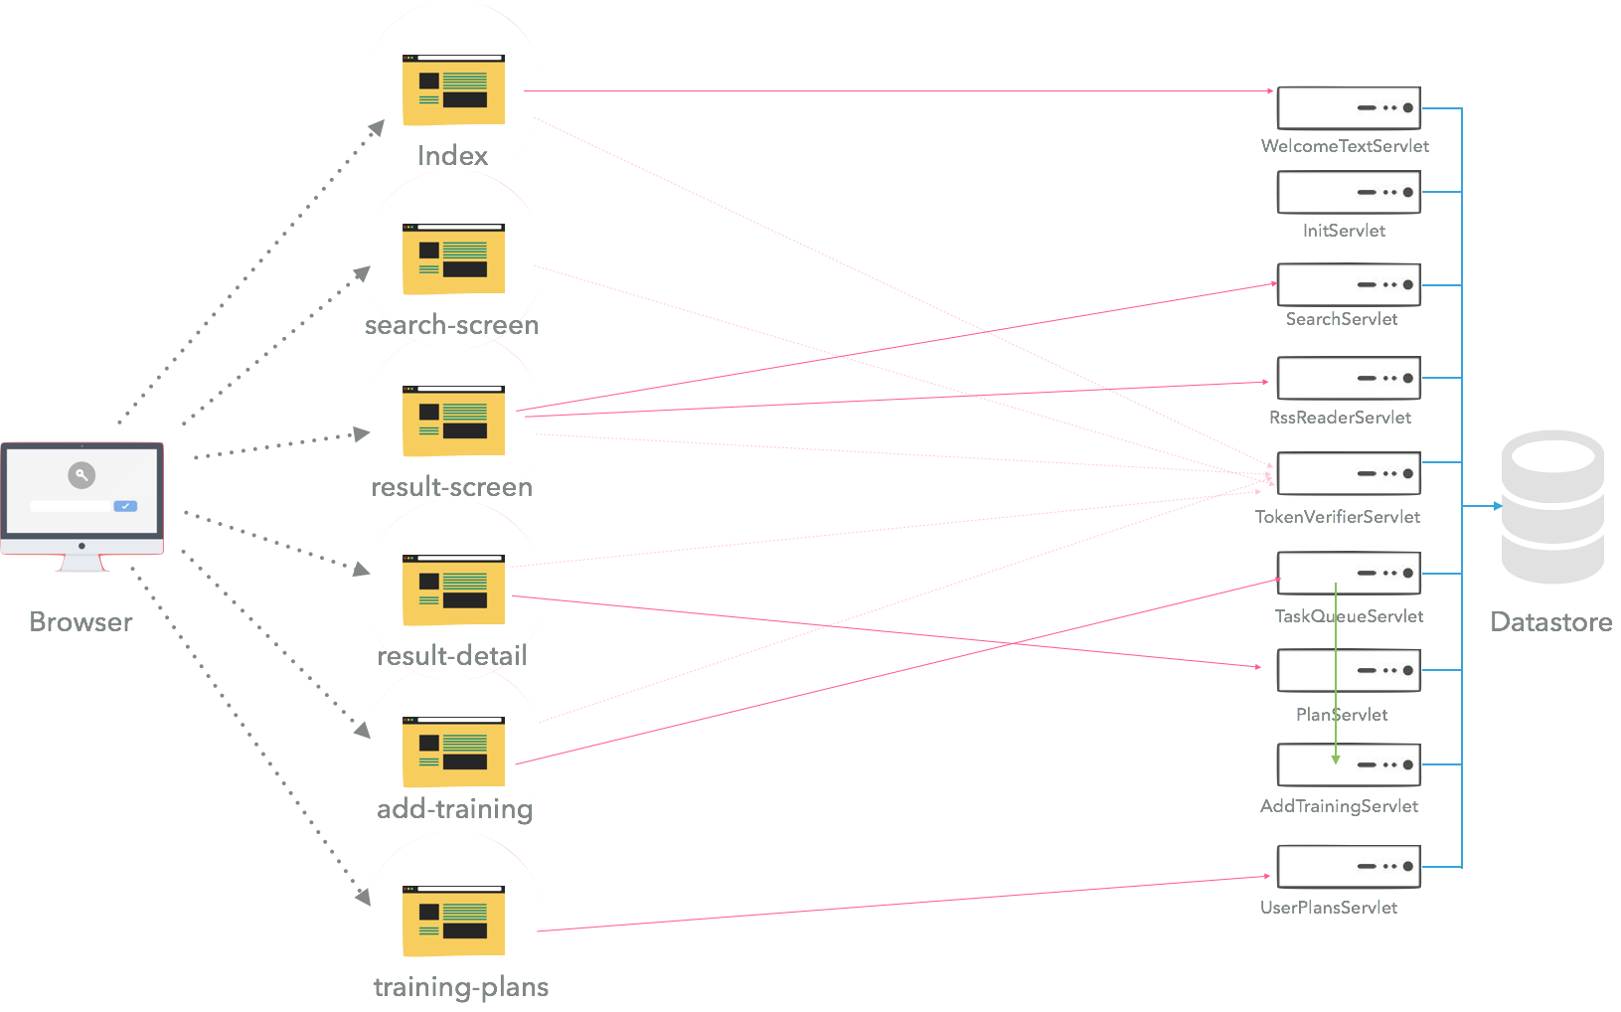
/welcomeText : GET
String welcomeText
/serch(text) : GET
List Plan, List Exo
/rss : GET
RSS BBCFeed
/plan (keyID) : GET
Plan plan
/addQueue (Plan): POST
Boolean isSuccess
/userPlans(mail) : GET
User user

